Slide 1
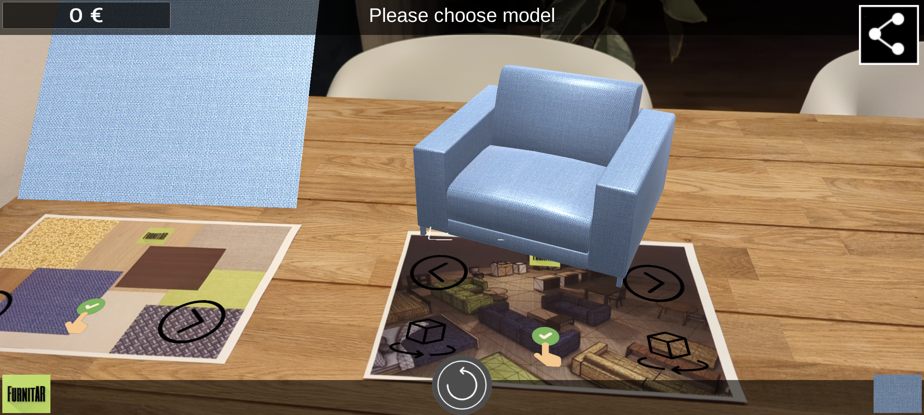

FurnitAR – Furniture Placement in AR
Android 8+
ARCore support required
Image Targets
Choose & rotate models
Choose materials
Groundplane
Place model on ground, desk, …
Place more or reset & restart
Technology used
Unity 2021.3.0f1 Personal (current recommended version)
Vuforia Engine 10.6.3 (latest version)
More details on github: https://barokai.github.io/FurnitAR/

